Slide 1
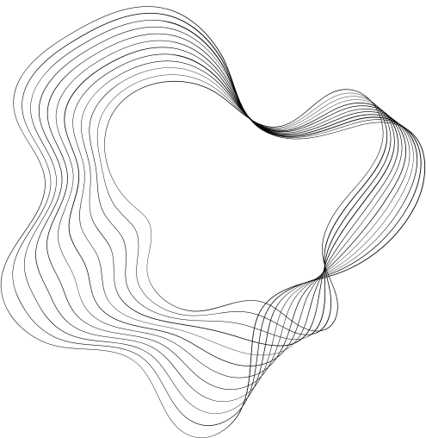

CAR PRICE PREDICTION
-VARUN DAS

Slide 2



PROBLEM STATEMENT
Develop a machine learning model that can accurately predict the price of used cars.

Slide 3

PROJECT FLOW
DATA GATHERING
DATA CLEANING
VISUALIZATION
BASIC MODEL
OUTLIER TREATMENT
MODEL
MODEL
FEATURE SELECTION

Slide 4
DATASET INSIGHTS
01
02
03
This dataset has 498484 rows and 11 columns.
The target column in this dataset is the selling price.
The target column in this data is numerical.

Slide 5
DATA CLEANING
01
MISSING VALUE TREATMENT
02
DATA TYPE CONVERSION

Slide 6
BASIC MODEL
 | Modelname | R-square | Adj-R2 | MSE
1 | Linear | 0.969657 | 0.969656 | 2.573992e+06
2 | Lasso | 0.969657 | 0.969656 | 2.574011e+06
3 | Ridge | 0.969657 | 0.969656 | 2.573992e+06
4 | RF-Regressor | 0.996358 | 0.996358 | 2.259267e+06
5 | DT Regressor | 1.000000 | 1.000000 | 5.260745e+06
6 | XGB Regressor | 0.976894 | 0.976893 | 2.518359e+06

Slide 7
CONCLUSION FROM BASIC MODEL
From the basic model we can conclude that linear,lasso and ridge gives the best result.
01

Slide 8

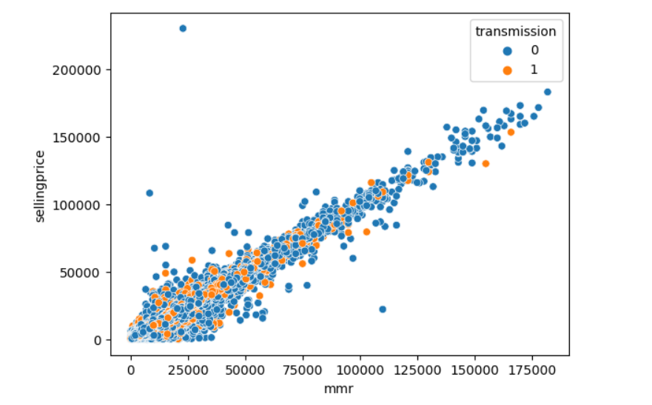
Visualization

Slide 9
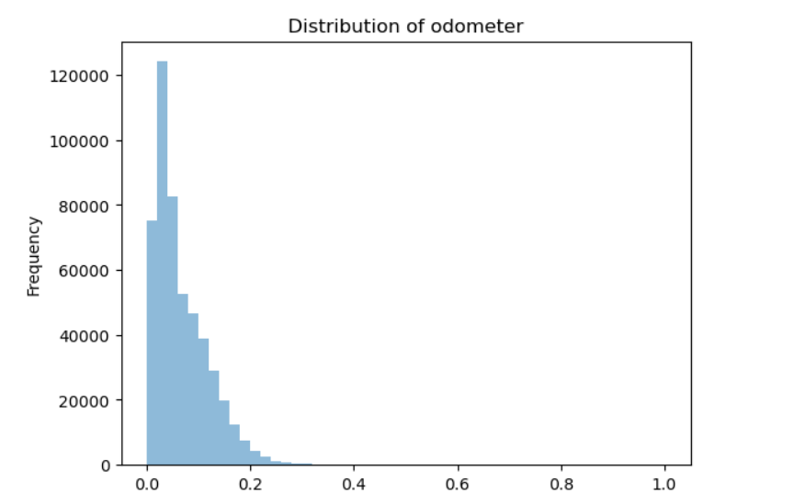
Visualization

Slide 10
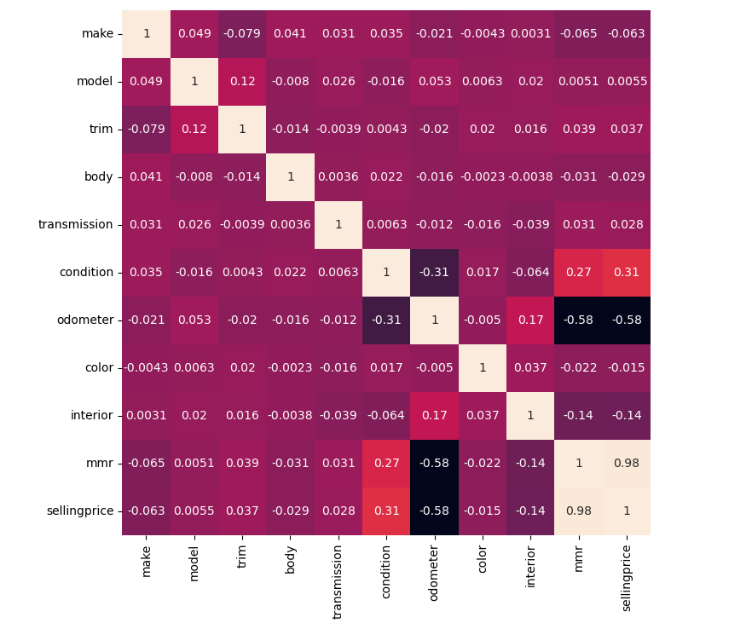
HEATMAP

Slide 11
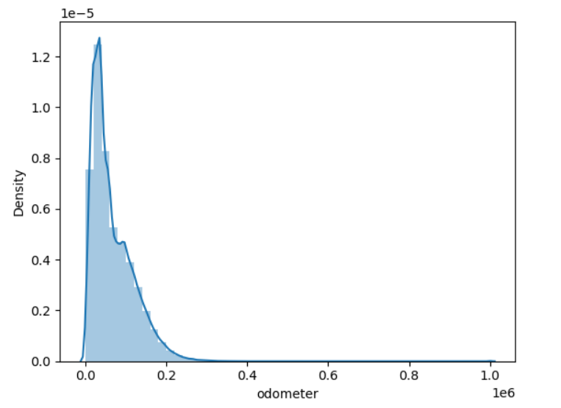
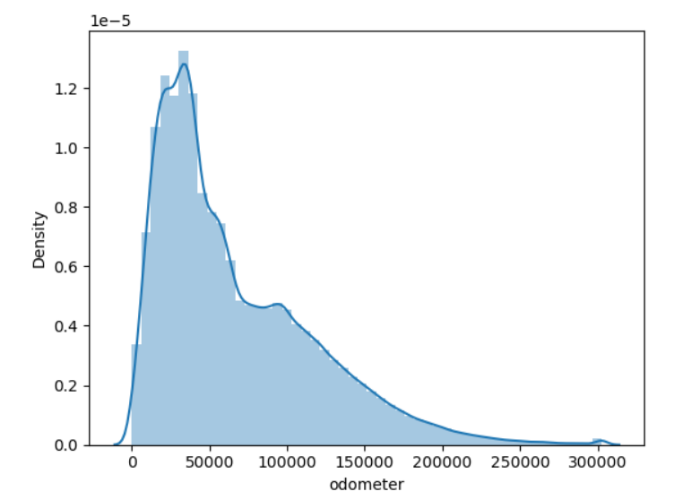
OUTLIERS TREATMENT
BEFORE OUTLIERS
AFTER OUTLIERS

Slide 12
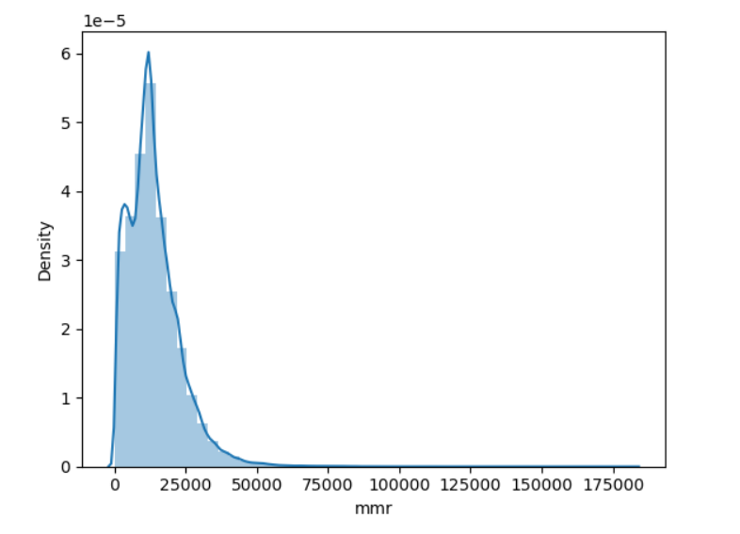
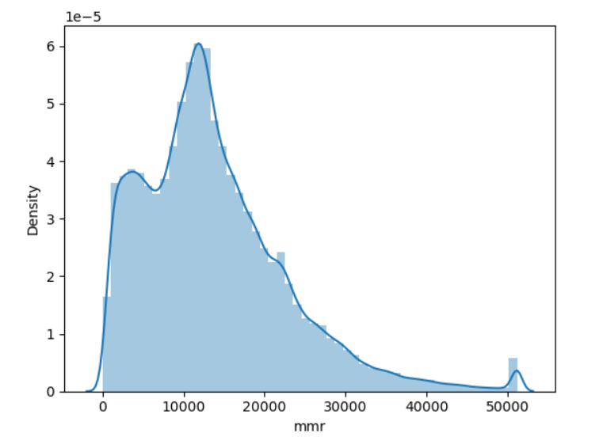
OUTLIERS TREATMENT
BEFORE OUTLIERS
AFTER OUTLIERS

Slide 13
MODEL
 | Modelname | R-square | Adj-R2 | MSE
1 | Linear | 0.870791 | 0.969656 | 1.071947e+07
2 | Lasso | 0.870791 | 0.969656 | 1.071942e+07
3 | Ridge | 0.870791 | 0.969656 | 1.071947e+07
4 | Adaboost Regressor | 0.586463 | 0.586452 | 3.826624e+07
5 | Gradient Boost Regressor | 0.959598 | 0.959597 | 3.338397e+06
6 | RF-Regressor | 0.995572 | 0.995571 | 2.730634e+06
7 | XGB Regressor | 0.974264 | 0.974263 | 2.902614e+06

Slide 14
CONCLUSION FROM MODEL AFTER OUTLIERS
From the model after outliers we can conclude that XGB regressor gives the best result with the adjacent R2 of 0.974263 and MSE of 2.902614e+06.
01

Slide 15
FEATURE SELECTION
USING LASSO COEFFICIENTS FROM LASSO REGRESSION
01

Slide 16
MODEL AFTER FEATURE SELECTION
 | Modelname | R-square | Adj-R2 | MSE
1 | Linear | 0.870791 | 0.969656 | 1.071947e+07
2 | Lasso | 0.870791 | 0.969656 | 1.071942e+07
3 | Ridge | 0.870791 | 0.969656 | 3.826624e+07
4 | Adaboost Regressor | 0.586463 | 0.586452 | 3.338397e+06
5 | Gradient Boost Regressor | 0.959598 | 0.959597 | 2.730634e+06
6 | RF-Regressor | 0.995572 | 0.995571 | 2.904997e+06
7 | XGB Regressor | 0.974264 | 0.974263 | 3.338397e+06
8 | Feature Selection | 0.972635 | 0.976893 | 2.904997e+06

Slide 17


CONCLUSION
Merrits
  The XGBoost model delivered a solid performance, slightly underperforming compared to gradient boosting, with an MSE of 2.904997e+06 on the dataset. XGBoost is known for handling various data types well, which supports its good performance here.
Demerits
  Although XGBoost is resistant to overfitting compared to traditional gradient boosting methods, it can still overfit if not properly tuned. Careful hyperparameter tuning and regularization techniques are necessary to mitigate overfitting and improve model generalization.

Slide 18

THANK'S FOR WATCHING

